Slide 1

SANDBAG
BUILDING
LOW CARBON FOOTPRINT, ECO FRIENDLY CONSTRUCTION

Slide 2
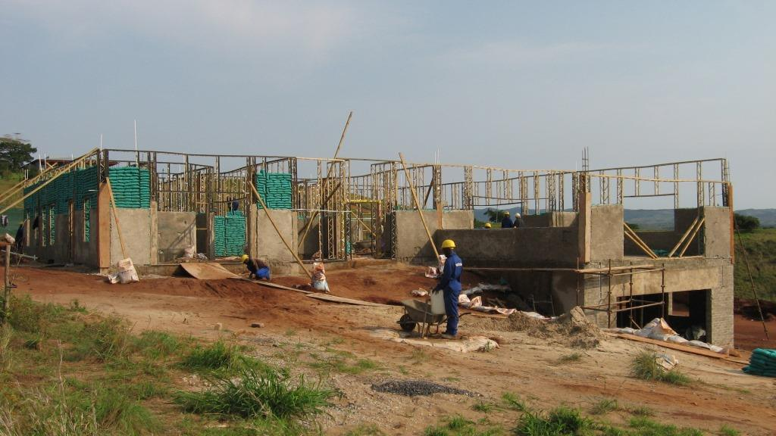
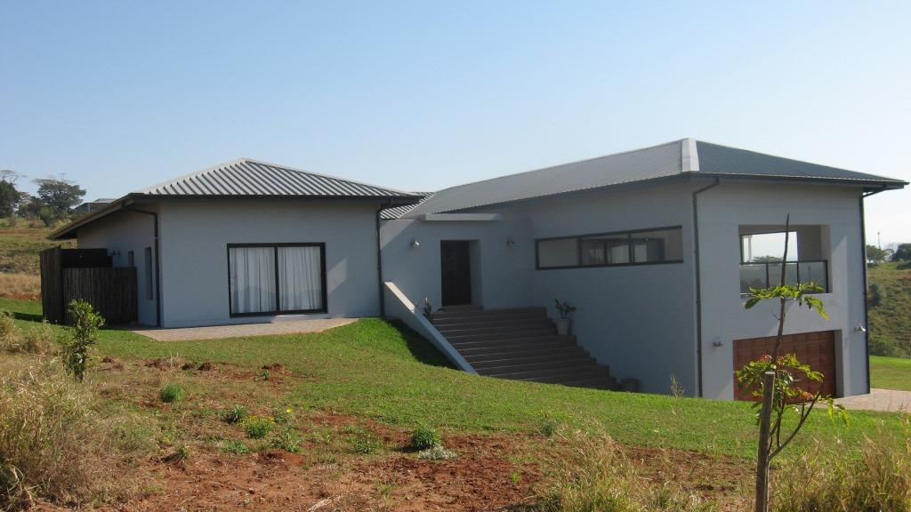
SandBag Building offers a low carbon footprint and an eco – friendly home. Construction cost is slightly less than that of conventional building.
Good thermal values (0.055 m²k/w)
Completely waterproof
Non combustible
40% heavier than brick construction
Low carbon footprint
Can be built to accommodate any design
Superior acoustic properties

Slide 3
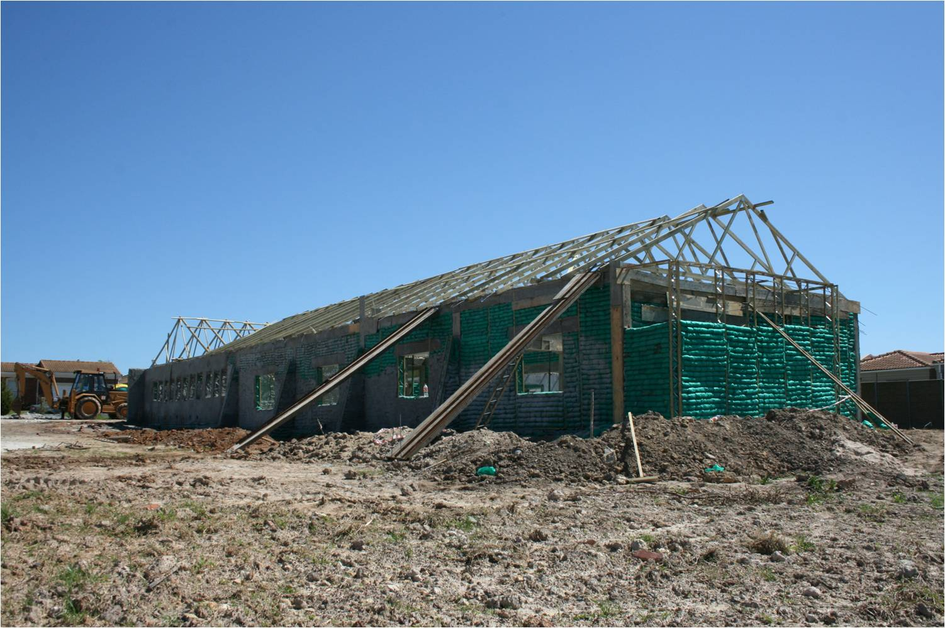
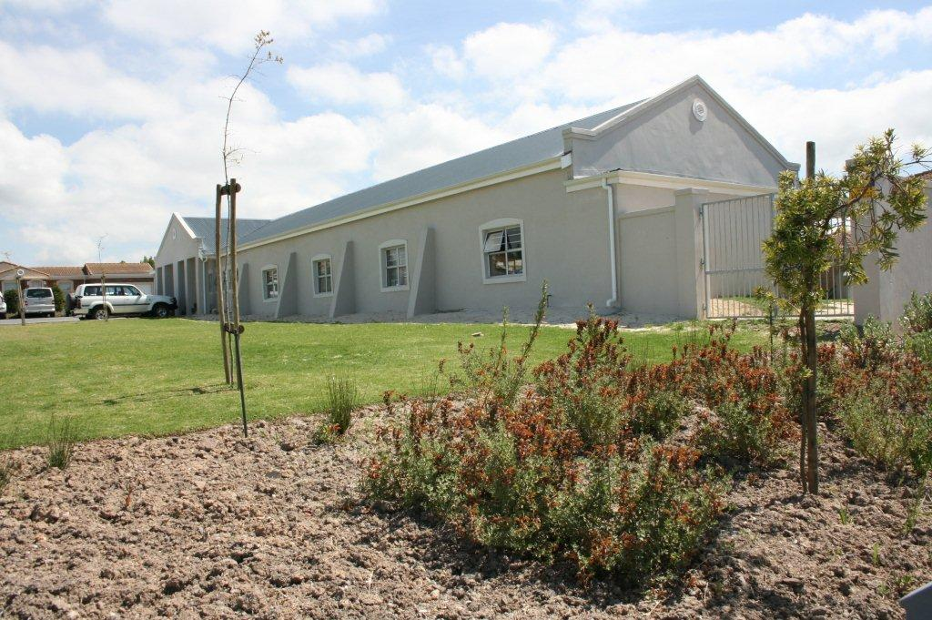
The carbon footprint of Sand-Bag Building is much lower than conventional construction. The carbon dioxide emission of a 1m² SandBag wall is 84% less when compared to a brick wall.
The SandBag Building process is much quieter than conventional construction. Very suitable for construction of homes within upmarket housing estates.

Slide 4
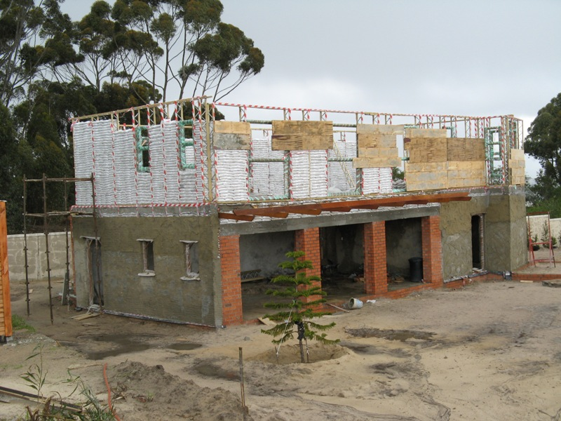
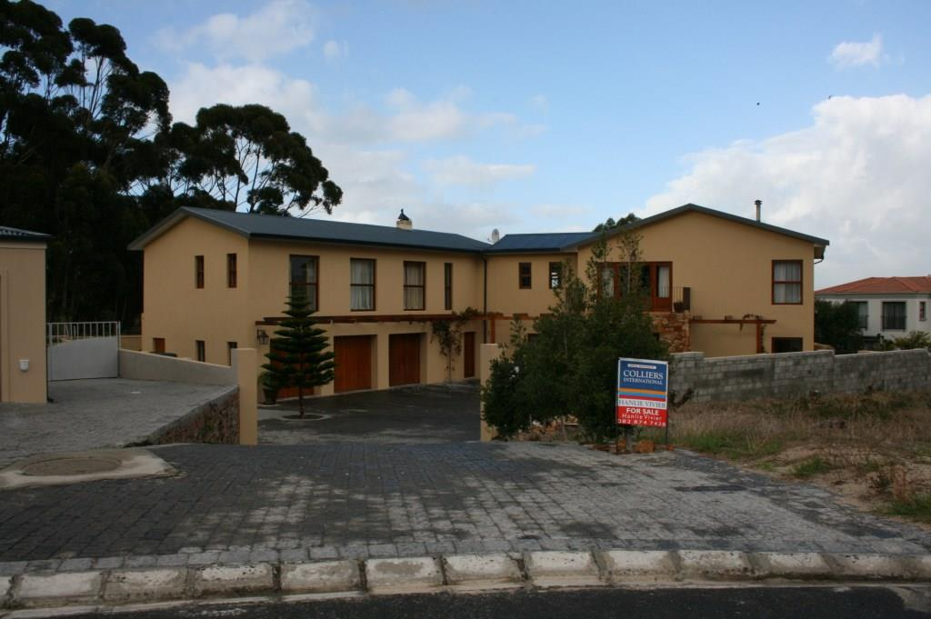
On site rubble is almost eliminated. Landfills are not part of the SandBag construction process.
Unlike conventional construction which experiences huge losses as a result of broken bricks and wasted mortar, very little wastage occurs with SandBag construction.
No electricity is required on a SandBag Building site
Water requirements are minimal, as the main construction process uses no mortar.

Slide 5
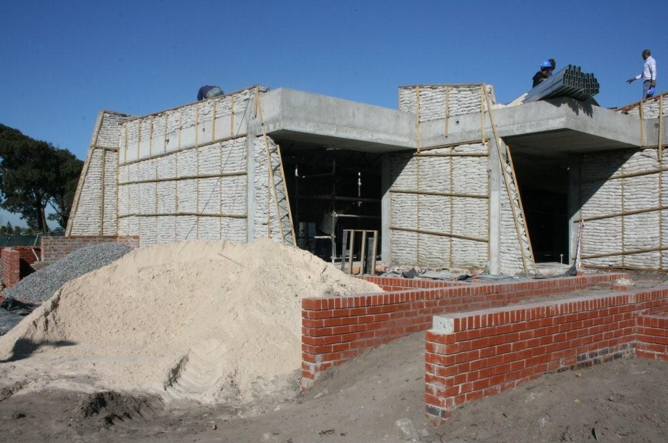
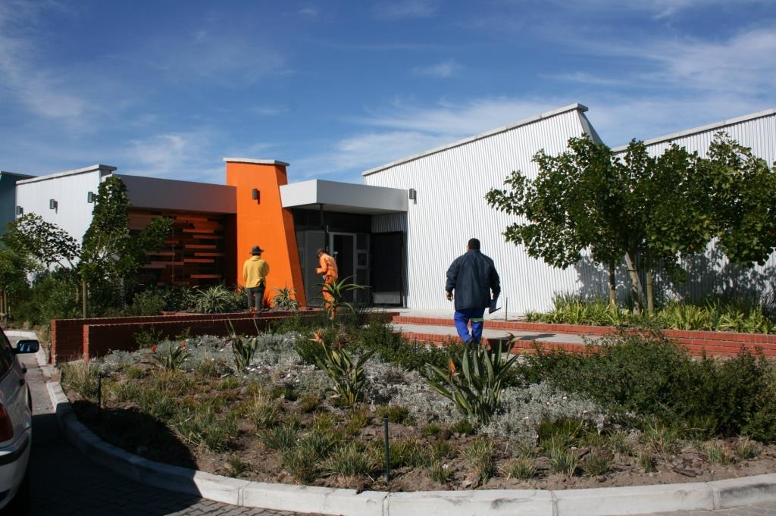
Local site sourced fill material could be used to fill the SandBags. This reduces transport costs substantially.
The SandBag Building system epitomizes a low environmental impact system. Not only is the use of resources reduced, but the SandBag material is recyclable. The raw material from which the SandBag is made of, is a by-product of the refining of crude oil into petroleum.

Slide 6
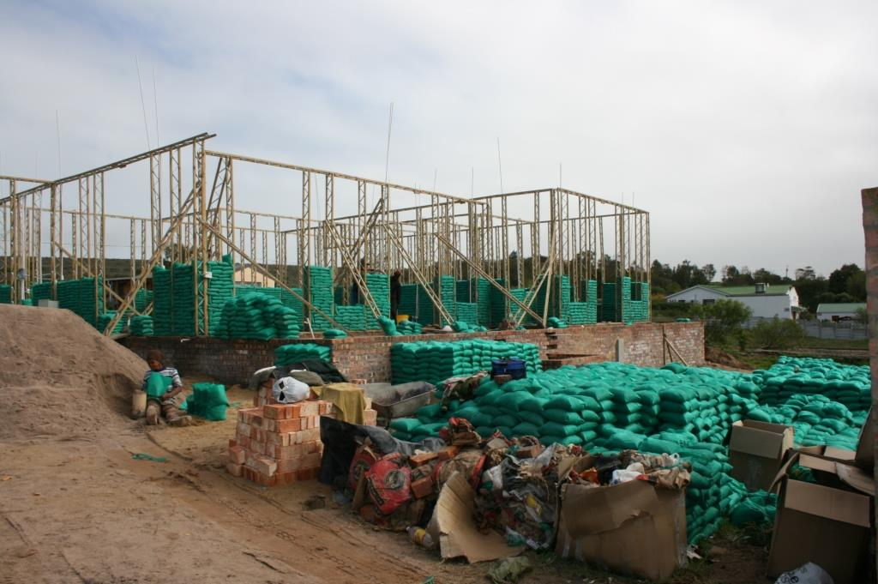
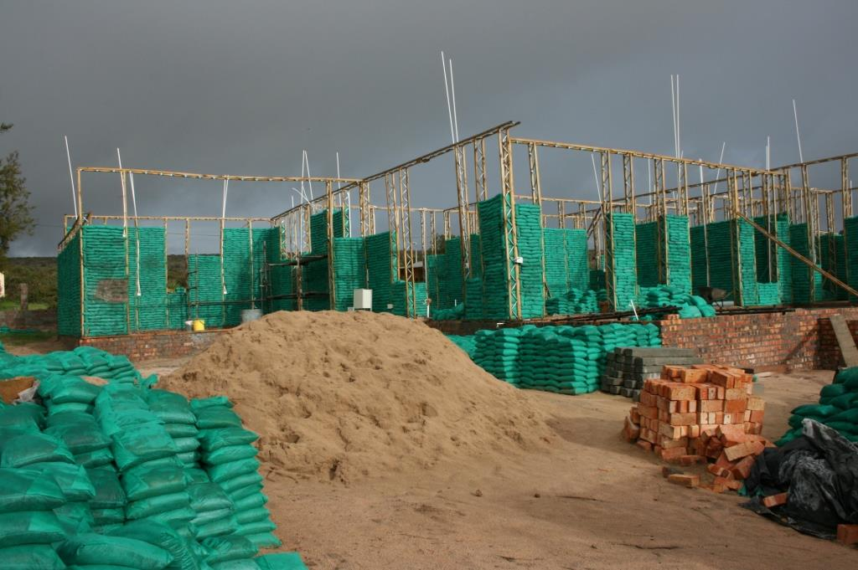
2 000 SandBags fit inside the boot of a car and weigh only a few kilograms. This is equivalent to 6 084 bricks over the same area of an exterior wall.
Construction could take place at locations where road access is not available. This reduces damage and congestion caused by heavy trucks which carry bricks and cement.
Sand can be found almost anywhere in the world. In some regions even directly on the construction site. The sand makes up 86%of the weight of the walls materials.

Slide 7
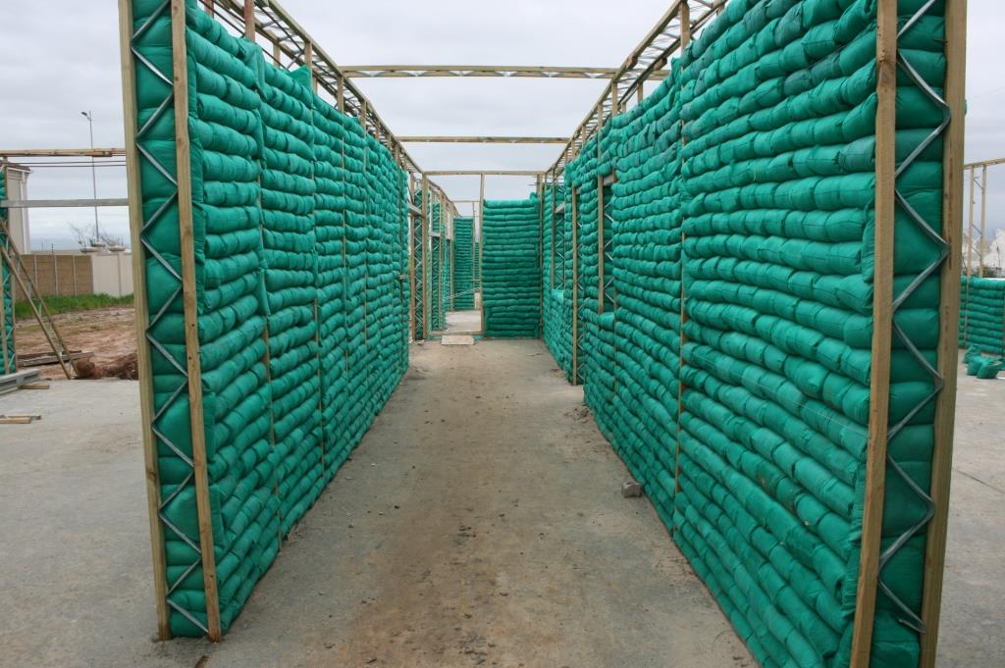
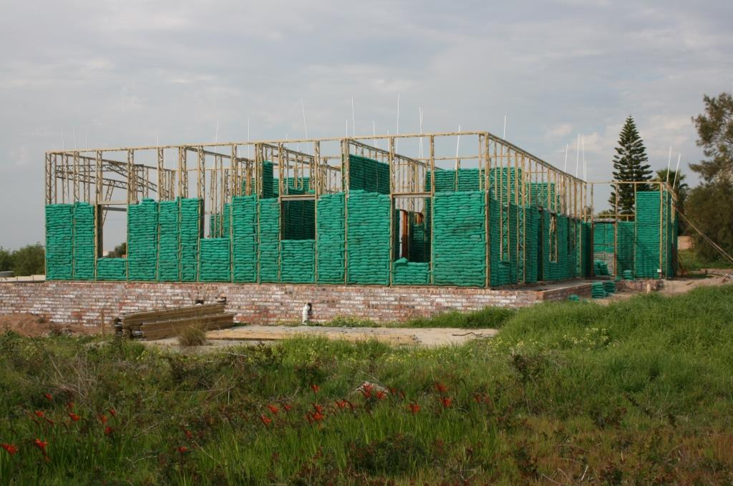
The SandBag Building system resists water penetration due to the fact that the sand in the bags acts as a filter medium – any water penetrating the plaster will simply “filter” down to the damp course and exit the wall to the outside.
The thermal insulation of a SandBag wall results in drastically reduced heating and cooling costs over the life of the building , especially when combined with appropriate passive thermal design.
Even in hot climates, airconditioning can often be eliminated. The life cycle carbon footprint of SandBag construction is a fraction when compared to a conventionally built house.

Slide 8
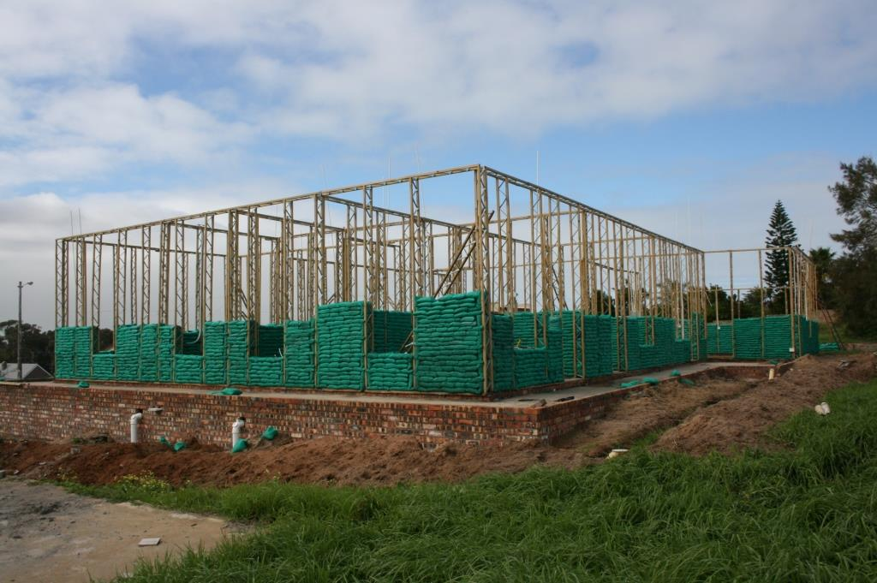
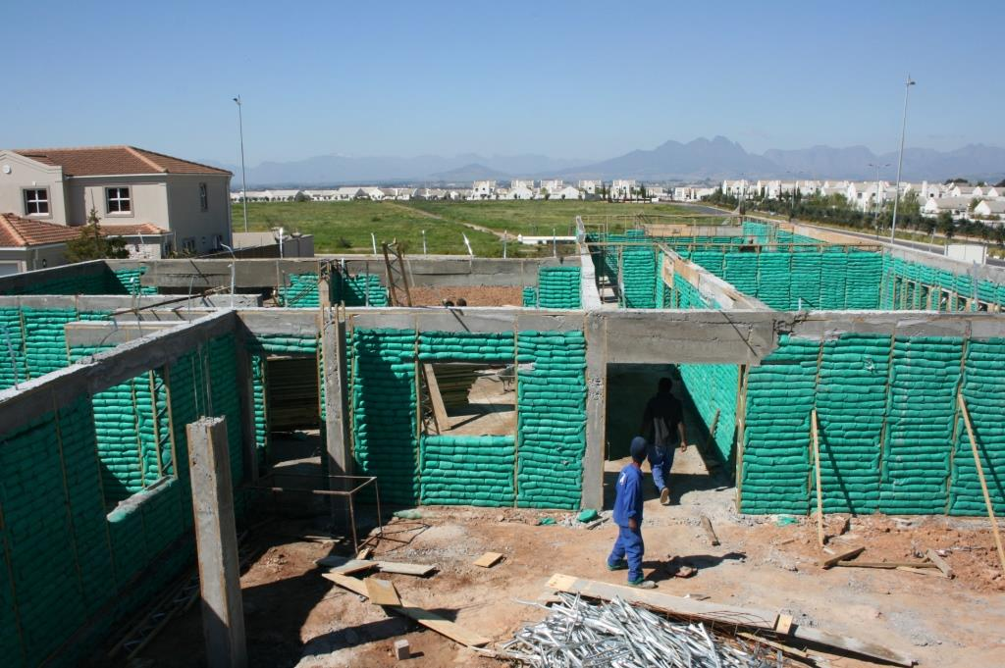
SandBag Building is heavier than conventional brick construction. This creates a structure that is resistant to damage from wind.
The wet bags behind the plaster enable the plasterwork to cure instead of merely drying. The end result is a very hard and reinforced cement finish.
Construction rate of SandBag Building can be rapid, which will contribute towards the building cost being reduced.
In many cases SandBag Building can reduce building cost by some 20% - especially in rural areas.

Slide 9
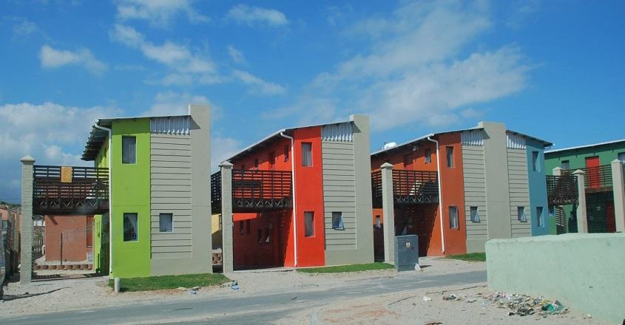
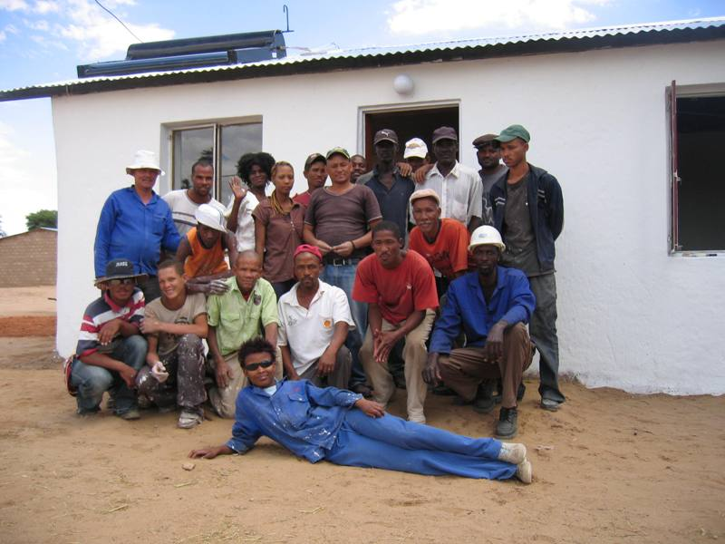
The only wet trade is the plasterer, who applies the mortar in exactly the same manner as would have been done for conventional construction.
On the basis of concrete support pillars and ring-beams, double storey construction is possible
All electrical conduit, water and waste water pipes are recessed into the SandBag walls prior to plastering.
In the case of low cost housing developments, all members of the community could get involved. This would help create a sense of ownership, belonging and contribution among the community.

Slide 10
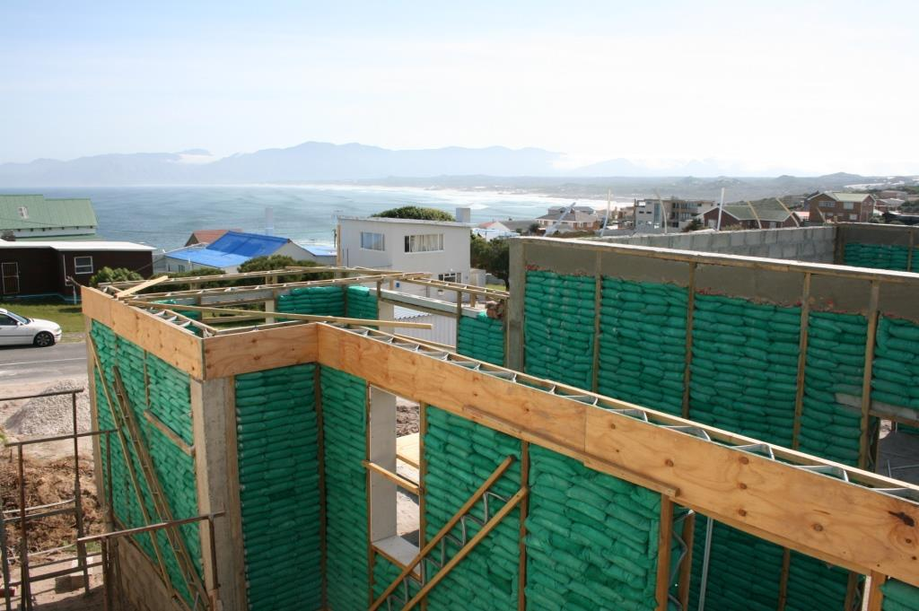
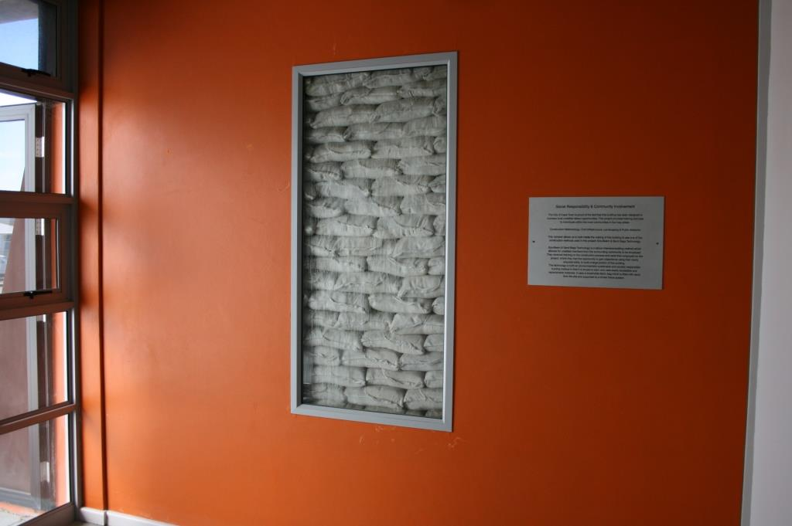
Houses built using the SandBag method of construction look and feel exactly the same as a plastered brick structure.
This eco-friendly method of construction is superior to a brick wall in so many ways - being waterproof, fireproof, acoustically superior and thermally efficient.
SandBag construction produces a healthier structure, since it is free of mould, damp and spore.
SandBag construction provides a more comfortable, quieter and secure home while still being able to save energy, save money and provide a healthier structure to live within.

Slide 11
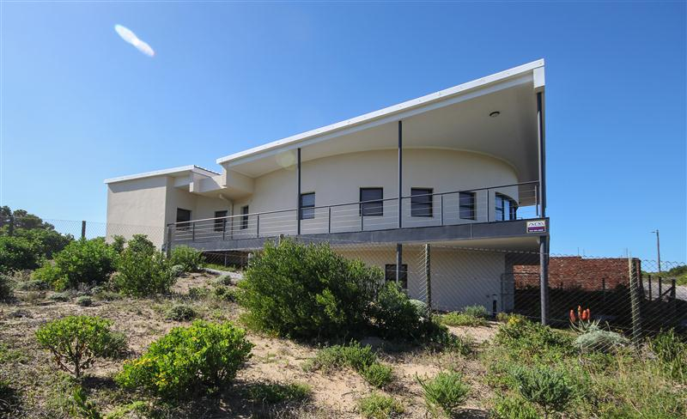

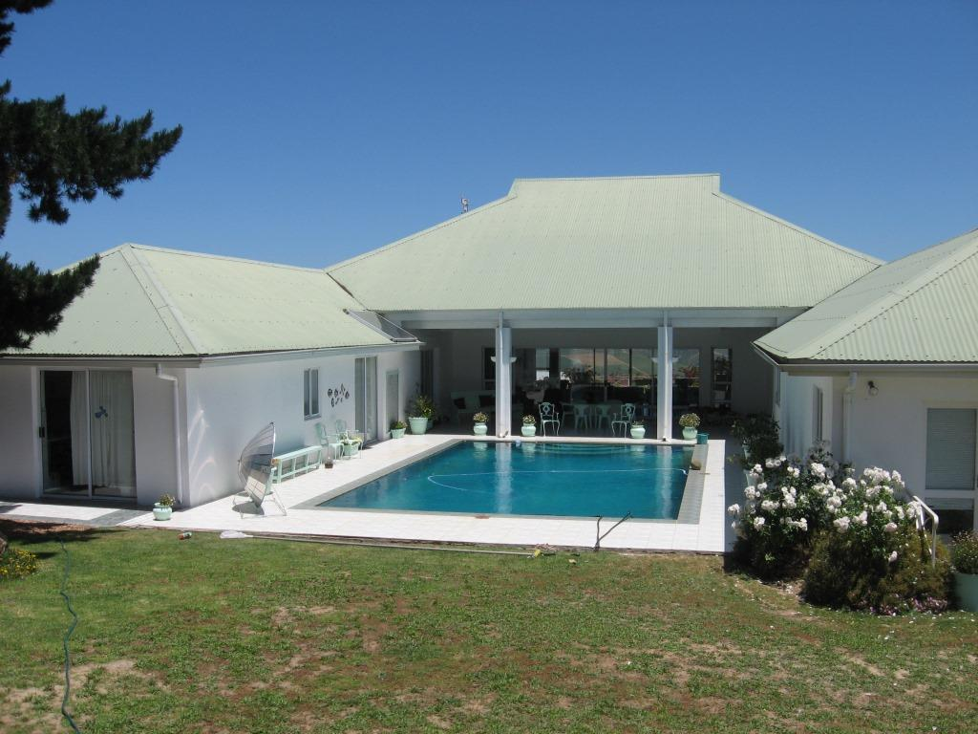
GREEN PERSPECTIVES
Andy Strydom 083 445 5123
www.ecobuilders.co.za
info@ecobuilders.co.za

